Slide 1

SOFTWARE TESTING FOR ECOMMERCE WEBSITE FLIPKART
K.Kiran Kumar reddy
192011303
CSA3731-Software Testing

Slide 2
Abstract
The purpose of the project is to test the ecommerce website like flipkart
E-Commerce website testing involves reviewing the website or web application for any issues before it goes live and is open to the public.
A web application requires testing on various features like security, functionality, database, etc.
This project presents the development of an automation-based testing framework, which supports and helps to implement easily new tests related to Web platforms analogous to E-commerce applications.

Slide 3
Objective
The dependability of software
Quality of software
Assurance of the System
Maximum capacity usage and performance

Slide 4
Proposed work eCommerce website testing involves reviewing the website or web application for any issues before it goes live and is open to the public. A web application requires testing on various features like security, functionality, database, etc.
Main Pages/Re-Direction/Links Testing;
Products Categories, Details and Search option Testing;
Content Detail and Management Testing;
Cross Sell and Up Sell Philosophy Testing;
Order Management Based Testing;
Payments Testing;
Analytics, Reviews & Ratings and User Profile Testing;
Promotions/Deals/Ads Testing;
Social Media Integration and SEO Testing;
Browser/Device Compatibility Testing;
Integration Testing;
Globalization Testing

Slide 5
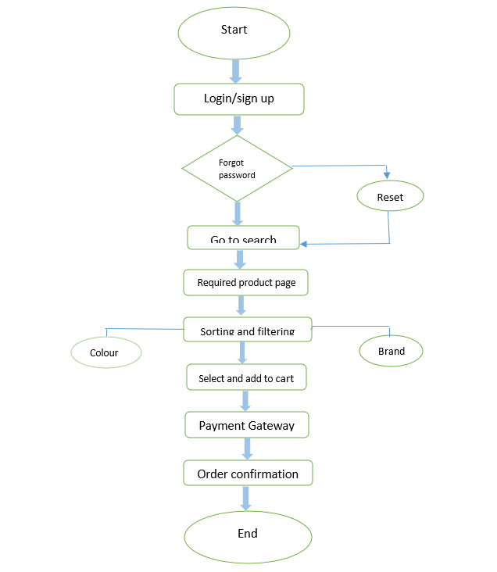
Flowchart

Slide 6
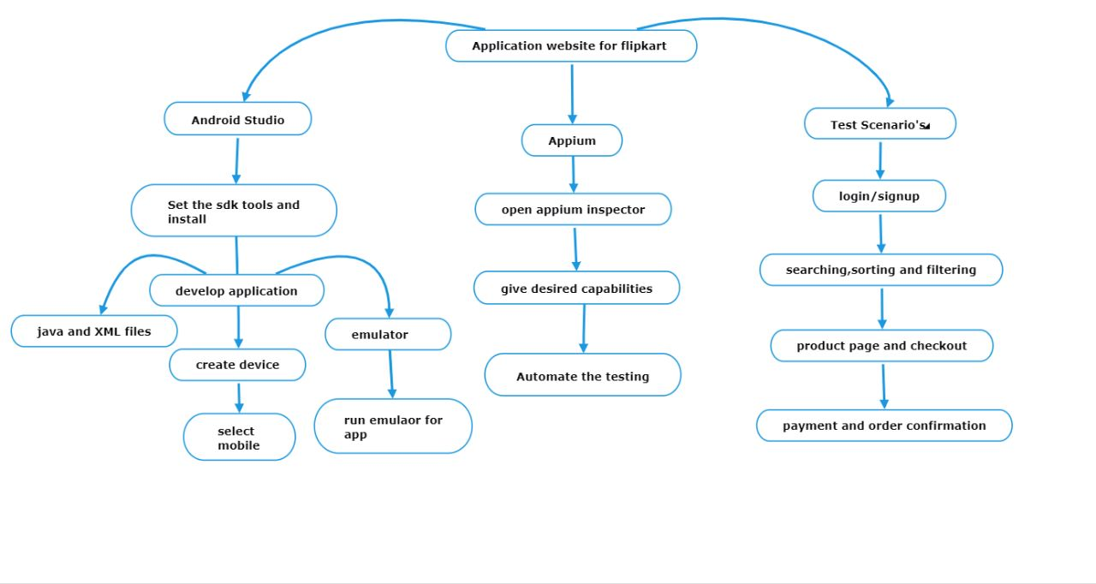
Concept map

Slide 7
Apps and tools installation
Android Studio
Appium Inspector
Appium server

Slide 8



Apps tools and installation

Slide 9
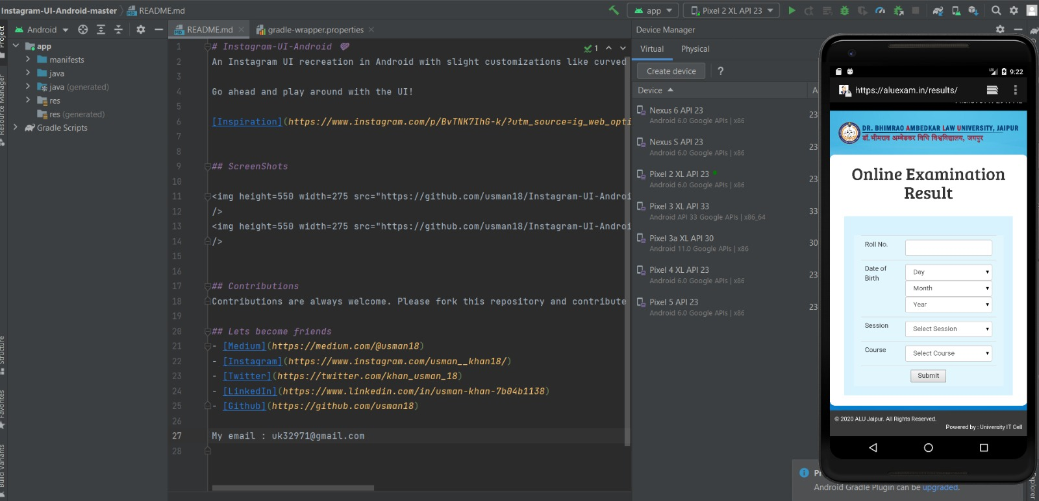
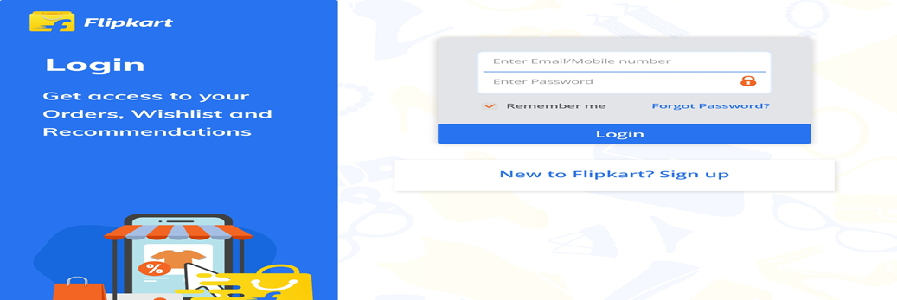
Implementation 1. Sign into your flipkart account.

Slide 10
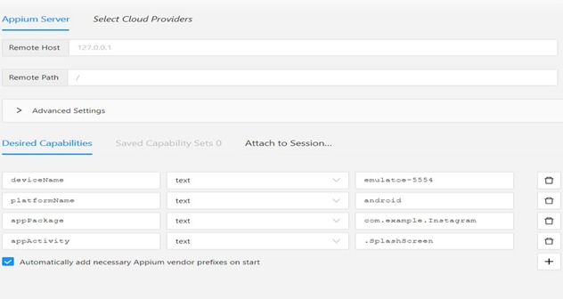

Slide 11
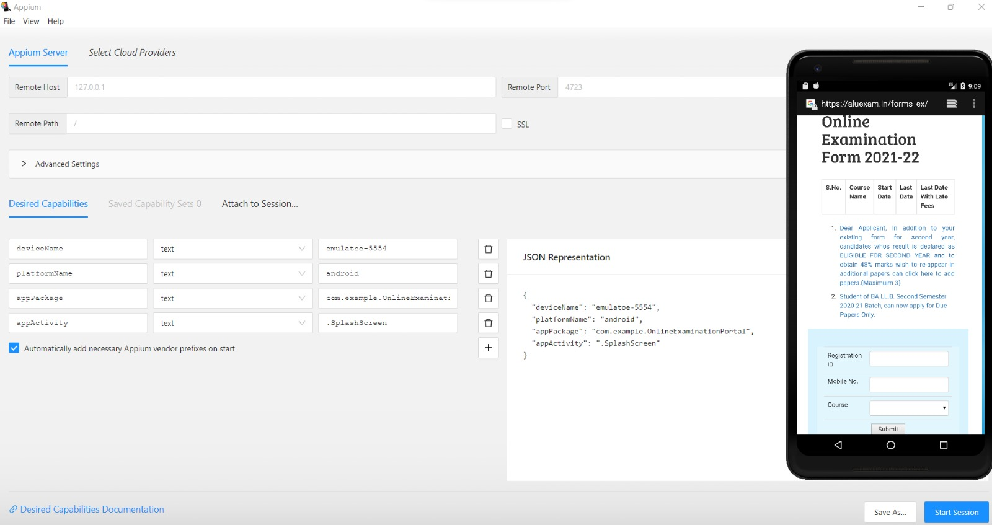
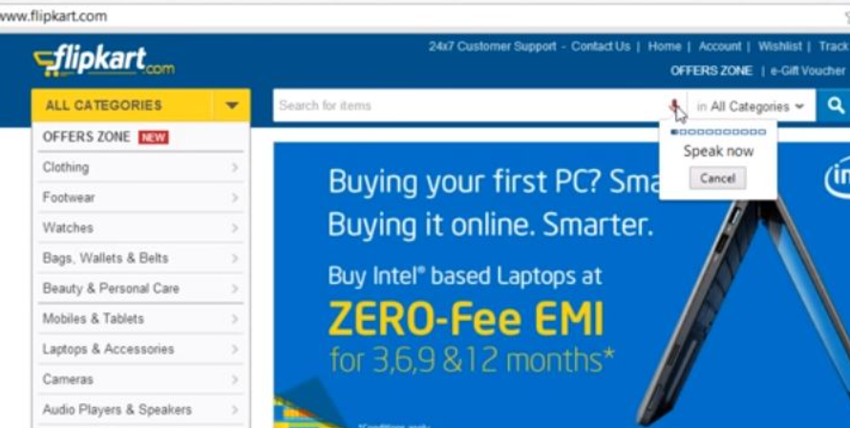

Slide 12
Test cases
TESTCASES | POSITIVE/NEGATIVE
Verify if a user will be able to login with valid username and valid password. | positive
Verify if a user cannot login with a valid username and an invalid password. | negative
Verify that on searching, all the products satisfying the search criteria are visible on the search result page. | positive
Verify if User search for product and it does not show the product. | negative
Verify that filtering and sorting works correctly on the search result page. | positive
Verify that filtering and sorting does not works correctly on the search result page. | negative
Verify that on the product page, the user can select the desired attribute of the product e.g. size, color, etc. | positive
Verify that the user cannot add to the cart one or more products. | negative
Verify that the user cannot add to the cart one or more products. | Positive

Slide 13
Conclusion
We finally navigate the Flipkart web application and find out the positive/pass and negative/fail test cases.This is to improve the application performance in better manner

Slide 14
Thank you

